Slide 1

Webinar on Collaborations in Early Child Care and Education
April 6th, 2011

Slide 2
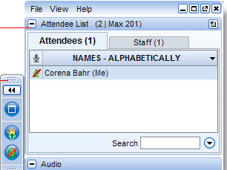




Instructions for GoToWebinar Menu Window
To hide Control Panel
To show Control Panel
View Webinar in Full Screen
Mode/Minimize Full Screen Mode
Green arrow means hand is NOT raised
(Click to raise your hand)
Red arrow means hand IS raised
(Click to lower your hand)
*Please use *6 or a mute button to silence your telephone when you are not speaking* To unmute your phone press *6 a second time.
Notes:
David?

Slide 3
Collaborations in Early Child Care and Education
Facilitator:
  Dr. Beth Rous- University of Kentucky
Presenters:
  Dr. Jessica Sowa- University of Colorado
  Dr. Rolf Grafwallner- Maryland State Department of Education
  Dr. Heather Rouse- Philadelphia Policy and Analysis Center
Materials from the meeting are available on Research Connections (www.researchconnections.org) under 'Collaborative Projects'

Slide 4
Collaborations in Early Child Care and Education
Workgroup Meeting, May 2010
  Overall goal
    To construct a framework for research and evaluation regarding collaborations in early care and education
  Parameters of discussion
    State-level collaboration
    Early education programs – child care, Head Start, pre-k, early intervention, and early childhood special education
    Process of collaborating (vs. collaborative institution/body)

Slide 5
Collaborations in Early Child Care and Education
Broad questions addressed at the workgroup meeting
  What is known, what needs to be known, and what are the appropriate approaches to take to further research and evaluation in the field?
  What are the important measurement and design issues?
  How can research help identify effective collaboration? What about these collaborations is effective? For whom are these collaborations effective?

Slide 6
Collaborations in Early Child Care and Education
Setting the context
  Increased emphasis on cross sector collaboration
  High need for Collaborative Leadership
    “a potential solution for easing the burden” on leaders through “shared responsibility and mutual accountability toward a common goal or goals” (Arnold, 2004, p. 5).
  Key aspects of collaborative leadership
    mutual openness and trust,
    individual commitment and organizational purposes,
    shared vision of goal accomplishment reinforced through shared experiences and action
      (Bryk & Schneider, 2002; Donaldson, 2006; Kouchanek, 2005; Telford, 1996).

Slide 7
Collaborations in Early Child Care and Education
The Reality
  Need to build relationships again and again and again…..
    Constant changes in leadership roles
  Fighting the natural urge to work with those who are closely aligned in philosophy, areas of interest, etc.
  Strong collaborative relationships
    can take extensive human and fiscal resources to build
    can produce lasting impacts on programs, children and families, but……
    are extremely easy to disrupt or destroy by a change in program focus, policy or people.

Slide 8
Collaborations in Early Child Care and Education
Resources and Federal/State Initiatives
Leader Focus
Collaborative Energy
Leadership Change
Collaborative History and Approach
Changes in Relationships
Number of Agencies
Leader Focus and Knowledge
Collaborative Will & Energy

Slide 9
Collaborations in Early Child Care and Education
Coming Next…..
  Clarifying Questions – use chat
  Hold other questions/comments to end – raise hands
Logic Model:
  Dr. Jessica Sowa, University of Colorado
Maryland’s Early Childhood System:
  Dr. Rolf Grafwallner, Maryland State Department of Education
Kids Integrated Data System (KIDS):
  Dr. Heather Rouse, Philadelphia Policy and Analysis Center

Slide 10
Collaborations in Early Child Care and Education
Logic Model-
  This logic model is a theory of change model (drawing on the Kellogg Foundation logic model types)
  Built on the following assumptions:
    Actors involved at state level are the policy level actors—referred to as stakeholders
    When examining how the inputs into the collaboration are converted into a process—concerned with the quality of the process
    Context matters—need to assess the environment in which these collaborations are being implemented

Slide 12
Collaborations in Early Child Care and Education
Issues to Consider with the Logic Model-
  Examples of how this would work in practice
  Designed for research, but could be tailored for evaluation purposes
  Could unpack the different components (A, B, C, D, and E) depending on the type of evaluation or the research question being explored
  Still a work in progress—needs to be applied to fully explicate the connections between the components

Slide 13
Collaborations in Early Child Care and Education
Maryland – Process Components of Collaboration
  Context 1: Consolidation of all early care and education programs at the Dept. of Education
  Context 2: Early Childhood Advisory Council – overarching early education policy

Slide 14
Collaborations in Early Child Care and Education
Context 1:
  Norms of collaboration defined by state agency within executive branch (e.g., legislative mandate, regulations, agency mission and policies)
  Facilitation by one Division working collaboratively with three other divisions (i.e., special education; food and nutrition, libraries, student and family support)
  Problem focus on school readiness and early learning opportunities gap (e.g., accountability system; strategic planning process)
  Support (e.g., agency infrastructure; budgeting process, enforcement authority)

Slide 15
Collaborations in Early Child Care and Education
Context 2:
  Norms of collaboration (e.g., Governor’s agenda; interest-based negotiations)
  Facilitation (e.g., state’s EC advisory council; Children’s Cabinet)
  Problem focus (e.g., school readiness, healthy children)
  Support (e.g., multi-agency approach; joint funding; legislative committees)

Slide 16
Collaborations in Early Child Care and Education
Outcomes in Maryland
  Shared problem definitions (i.e., school readiness; alignment with K-12)
  Fragmentation (i.e., streamlined decision-making; overlapping missions)
  Improved relationships and trust (e.g., long-term engagement; leadership (State Superintendent))
  Increased collaborative activity (e.g., joint funding; division of labor; local collaboration models)
  Increased political will (i.e., Children’s Cabinet; legislative committees; Governor; State Board of Education)

Slide 17
Collaborations in Early Child Care and Education
Issues:
  Maintaining transparency (e.g., dissemination pathways and current updates)
  Inclusion of Federal programs and mandates (e.g., redundancies and Federal to local oversight)
  Collaboration between LEAs and EC partners (e.g., transition practices and control of funding/oversight)

Slide 18
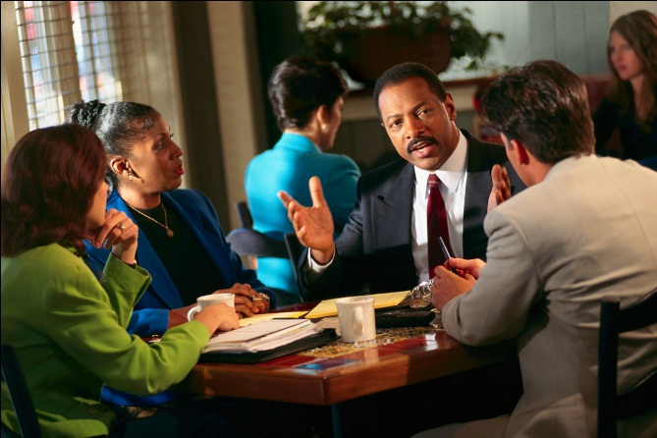
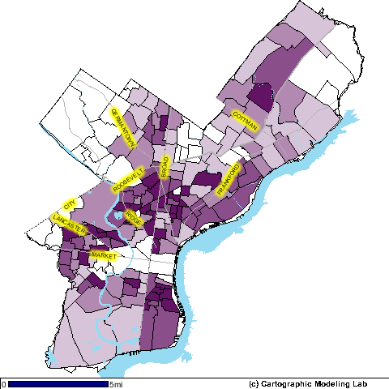


Kids Integrated Data System
Heather L. Rouse
Philadelphia Policy & Analysis Center
April 6th, 2011

Slide 19

Kids Integrated Data System
Integrates All Administrative Records for Children & Youth age 0 to 21
Provides Individual & GIS-based Data for
Policy Analysis, Community Planning & Research
Individual &
Aggregate

Slide 20
Kids Integrated Data System
WHO
University Researchers, Public Service Providers, & local Foundation
Co-Founders: John Fantuzzo, Dennis Culhane, & Trevor Hadley;
University of Pennsylvania
WHAT
Integrated Individual Child/Youth Data
  Child Welfare & Human Services
  Vital Statistics
  Health
  Department of Behavioral Health (mental health)
  Early Intervention
  Public Education
  Emergency Shelter Services and Supportive Housing

Slide 21
Value of Building Research Capacity with Municipal Administrative Data
It is there.
An infrastructure exists to collect it and maintain it.
It can be used to inform decisions at multiple levels
It can be used to build comprehensive models to foster understanding and to stimulate strategic planning.
It can create dialogue across agencies serving the same populations of children.
It can be used to share with the community to build support and focus community-wide action

Slide 22
Challenges of Collaboration:
A Tale of Two Realities
Government Policy & Practice
Academic Research

Slide 23
Government Policy & Practice
Data infrastructure?
Research capacity?

Slide 24
Academic Research
Time for partnerships?
You want the answer When?

Slide 25
Integration of Diverse Realities
Policy
Research
KIDS

Slide 26
HOW? Partnership Agreements & Protocol
Improvement of policies, practices,
data resulting from the research
Improve
Networks established to share findings
with relevant stakeholders and policy makers
SHARE
City research & evaluation applications
USE
Scientific processes to integrate
data with precision
INTEGRATE
Legal & ethical agreements
to get individual data from
multiple municipal agencies
GET

Slide 27
KIDS Legal Issues
HIPAA: Health Insurance Portability & Accountability Act
FERPA: Family Educational Rights & Privacy Act
Requirements for Use of Information:
Practical Use for agencies
Security Standards & Protocol for data use

Slide 28
KIDS Ethical Issues:
Disconnects between Research & Practice
FEARS
The research will not benefit our agency
We will lose control of how our data are used
Researchers will take our data and run with no regard for us or our work with children
The findings may contradict our own reports
Negative findings will be shared without our input creating misunderstandings

Slide 29
The KIDS Policy Group
Purpose: Govern all KIDS research projects to ensure agency-research connections
Process:
Each agency elects 1 representative
All research proposals are reviewed & voted
Approved projects must adhere to KIDS Researcher Agreements
Researcher conducts research & informs the Policy Group at every step

Slide 30
KIDS Data Integration Process
Routine data-dumps from agencies
Scientific audit system for “research-ready” data
KIDS Policy Group Approval for specific projects
Dataset integration tailored to project parameters
De-identified or aggregate data shared with researchers

Slide 31
Sample KIDS Policy Research
How do multiple risk factors impact school readiness?
What is the overlap between DOE Special Education Services and Community Mental Health Services?
How are educational outcomes affected by experiences in multiple public systems (e.g., Child Welfare & Shelter Services)?
What are the educational outcomes for children using different homelessness support services?
What are the characteristics of Out-of-School youth?
Are there disparities in care for children with ADHD?

Slide 32
Responses to Research Findings
Built Capacity: Early Care & Education Interview
Principal Training Academy for Kindergarten Transitions
Latino Taskforce on Early Childhood Education
Grant funding to establish a Summer Academy for children with no prior preschool experience
National funding for Out-of-School Youth interventions
Pilot project: Social Workers in Homeless shelters

Slide 33

Thank You
For More Information about KIDS:
Heather L. Rouse, Ph.D.
Deputy Research Director
Philadelphia Policy & Analysis Center
Heather.Rouse@Phila.gov (or)
rouseh@gse.upenn.edu

